Slide 1
Quantum Dynamics Simulation: Time-Dependent Schrödinger Equation with FDM

Slide 2
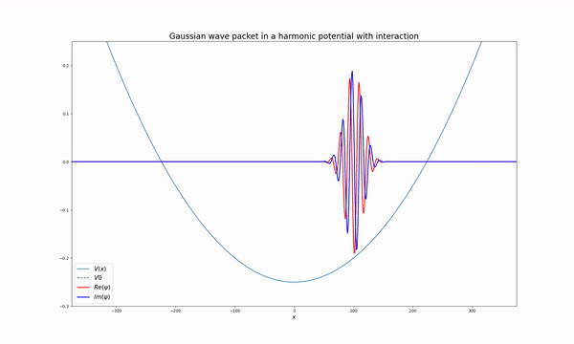
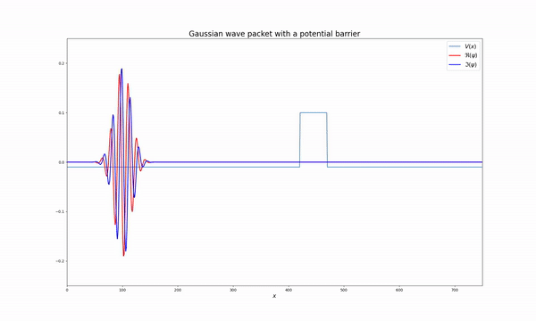
Introduction
time-dependent Schrödinger equation
FDM(Finite Difference Method)
simulations :

Slide 3
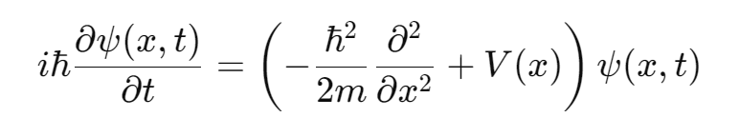
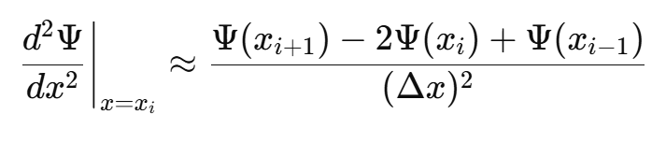
Background
time-dependent Schrödinger equation :
FDM :

Slide 4
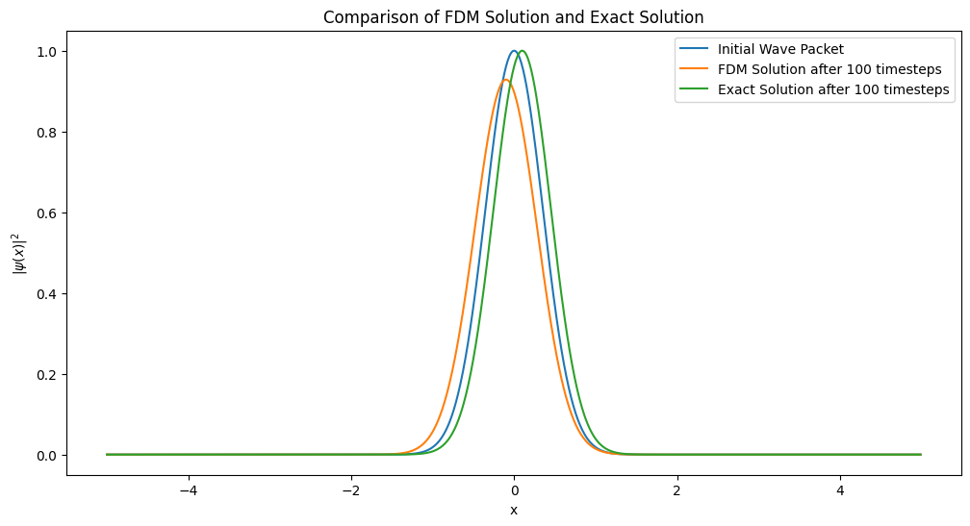
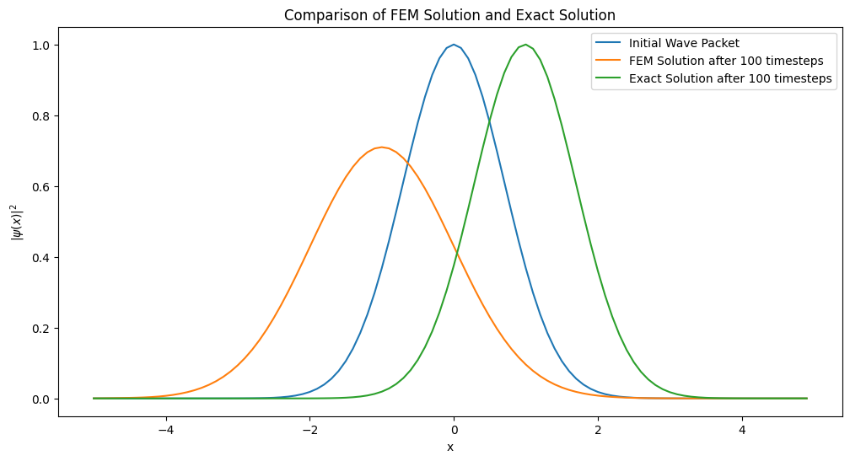
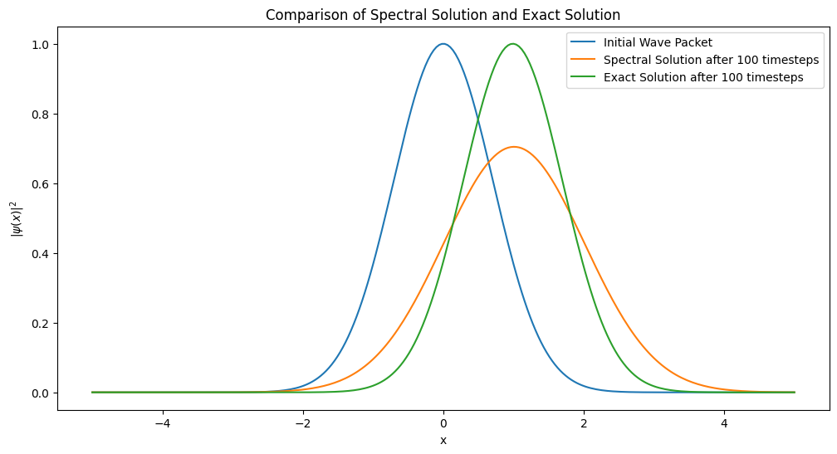
+) Why FDM
FDM is relatively simple to implement and is effective in solving the time-dependent Schrödinger equation. Additionally, this method is convenient for handling complex boundary conditions and is useful for modeling various physical systems.

Slide 5
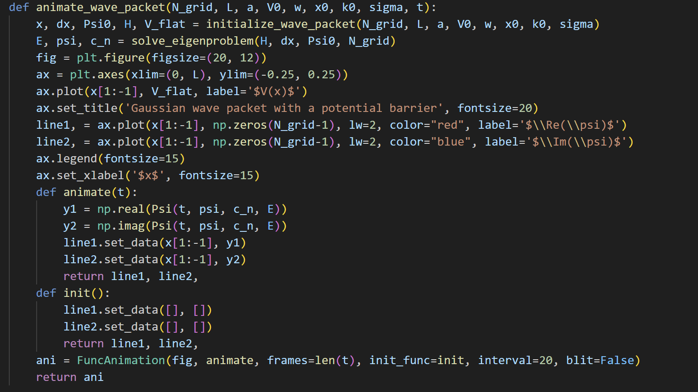
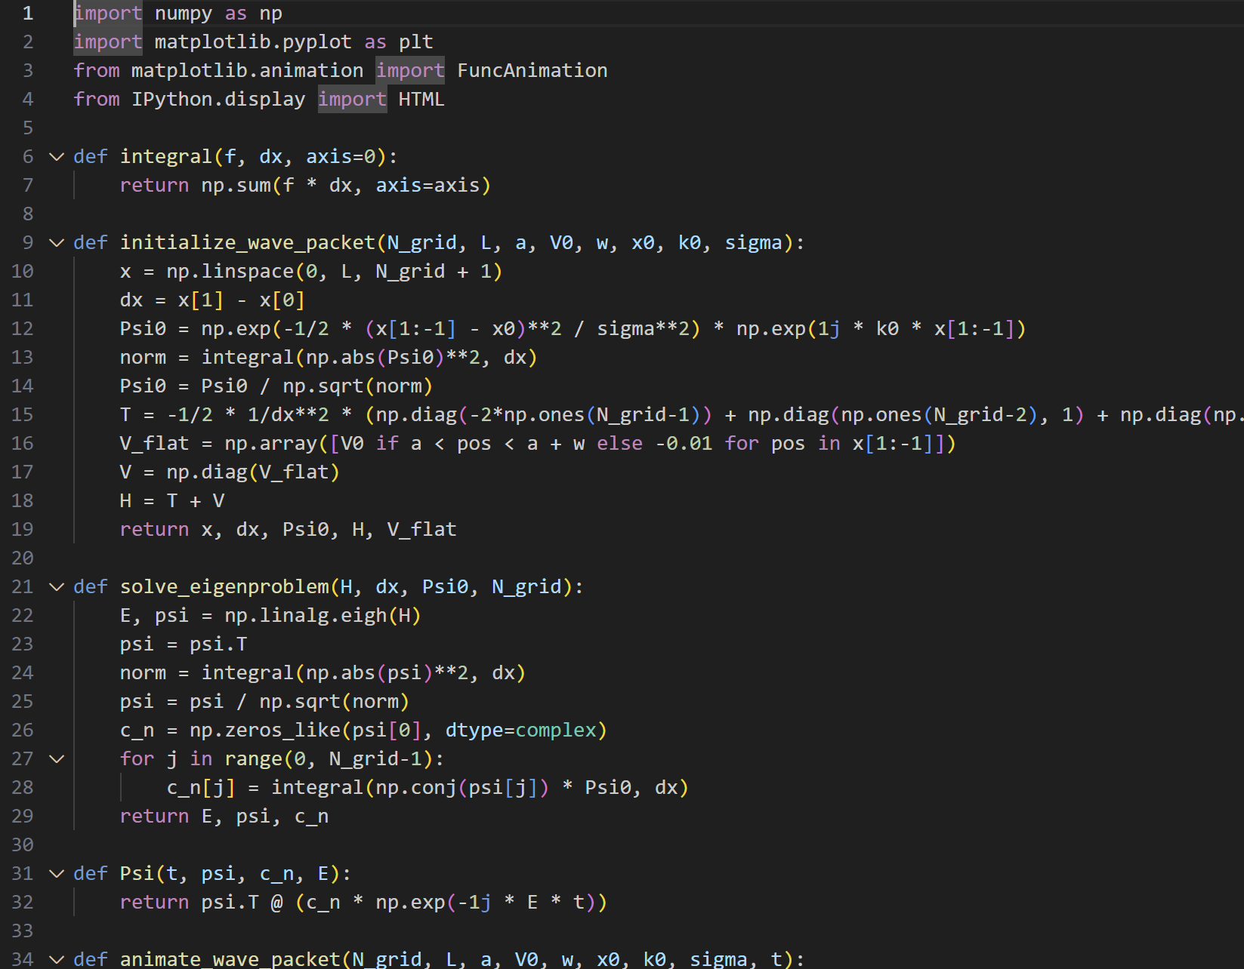
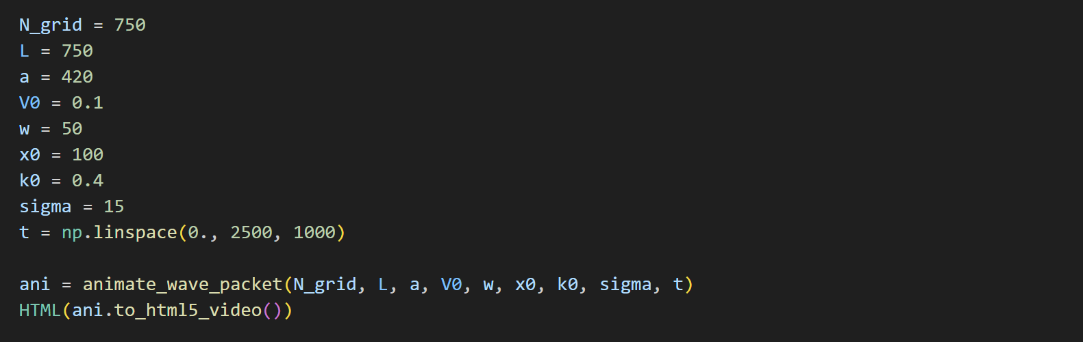
Code in Quantum Tunneling Simulation

Slide 6
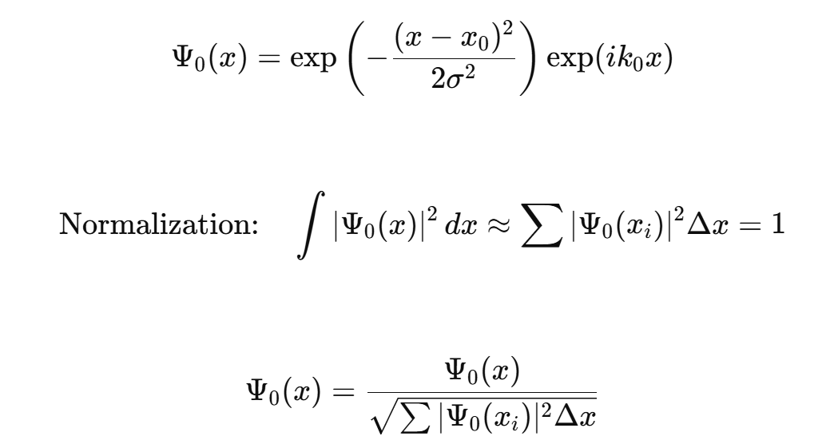
Code in Quantum Tunneling Simulation

Slide 7
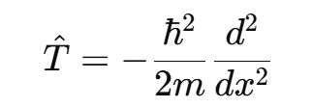
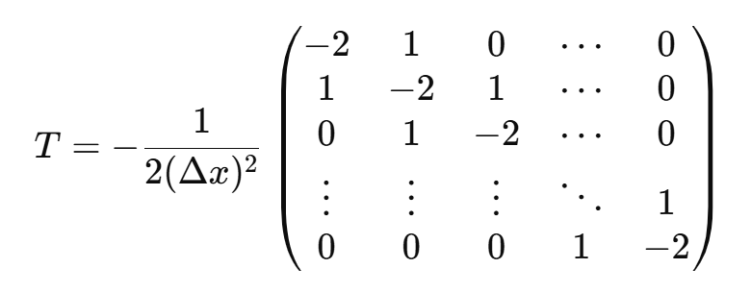
Code in Quantum Tunneling Simulation
T = -1/2 * 1/dx**2 * (np.diag(-2*np.ones(N_grid-1)) + np.diag(np.ones(N_grid-2), 1) + np.diag(np.ones(N_grid-2), -1))

Slide 8
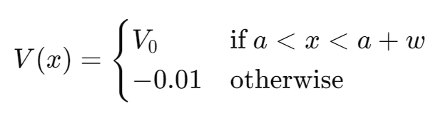
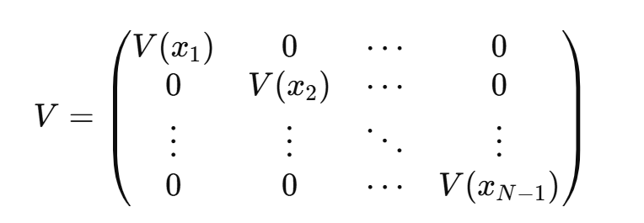
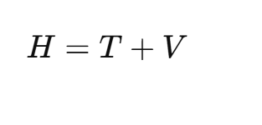
Code in Quantum Tunneling Simulation

Slide 9
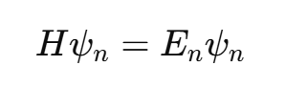
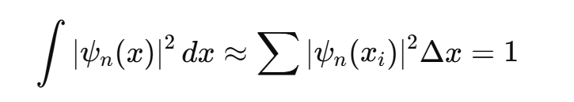
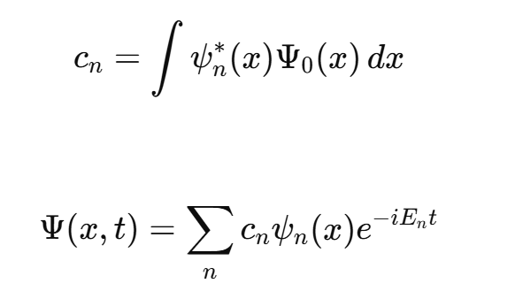
Code in Quantum Tunneling Simulation

Slide 10
Code in Quantum Tunneling Simulation
Animate Wave Packet
Give parameters

Slide 11
Result
Reflection and Transmission: Not all of the wave packet gets through the barrier. Some of it is reflected back.
Tunneling Probability: The probability of tunneling depends on the energy of the wave packet and the height and width of the barrier.

Slide 12
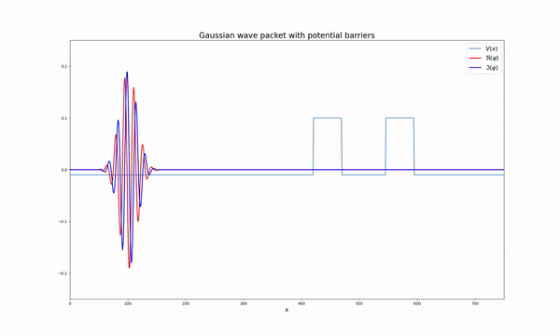
Results
Double Barrier Potential: This setup shows resonant tunneling, where certain energies allow the wave packet to tunnel more efficiently.
Oscillatory Motion: The wave packet exhibits periodic oscillations.
Energy Quantization: The harmonic oscillator has discrete energy levels, which dictate the oscillation frequency.

Slide 13
Limitation and Conclusion
Limitation: We have verified the performance of the FDM against theoretical values, but comparing the theoretical values of the transmission coefficient with the simulation results would yield even better insights.
Conclusion: Successfully performed the simulations in python with numerical methods.

